Slide 1


UNSUPERVISED LEARNING
Finding Hidden Patterns
Discovering Clusters & Structure
🎯 Clustering | 📉 Dimensionality Reduction
K-Means, Hierarchical, DBSCAN, PCA, GMM, t-SNE
LEARN
APPLY
MASTER

Slide 2
Overview of the Core Algorithms
K-Means Clustering
Partition into k clusters, centroid-based
Hierarchical Clustering
Build tree, agglomerative/divisive
DBSCAN
Density-based, finds arbitrary shapes
PCA - Principal Component Analysis
Reduce dimensions, variance preservation
Gaussian Mixture Models
Probabilistic clustering, soft assignment
t-SNE
Dimensionality reduction, visualization

Slide 3
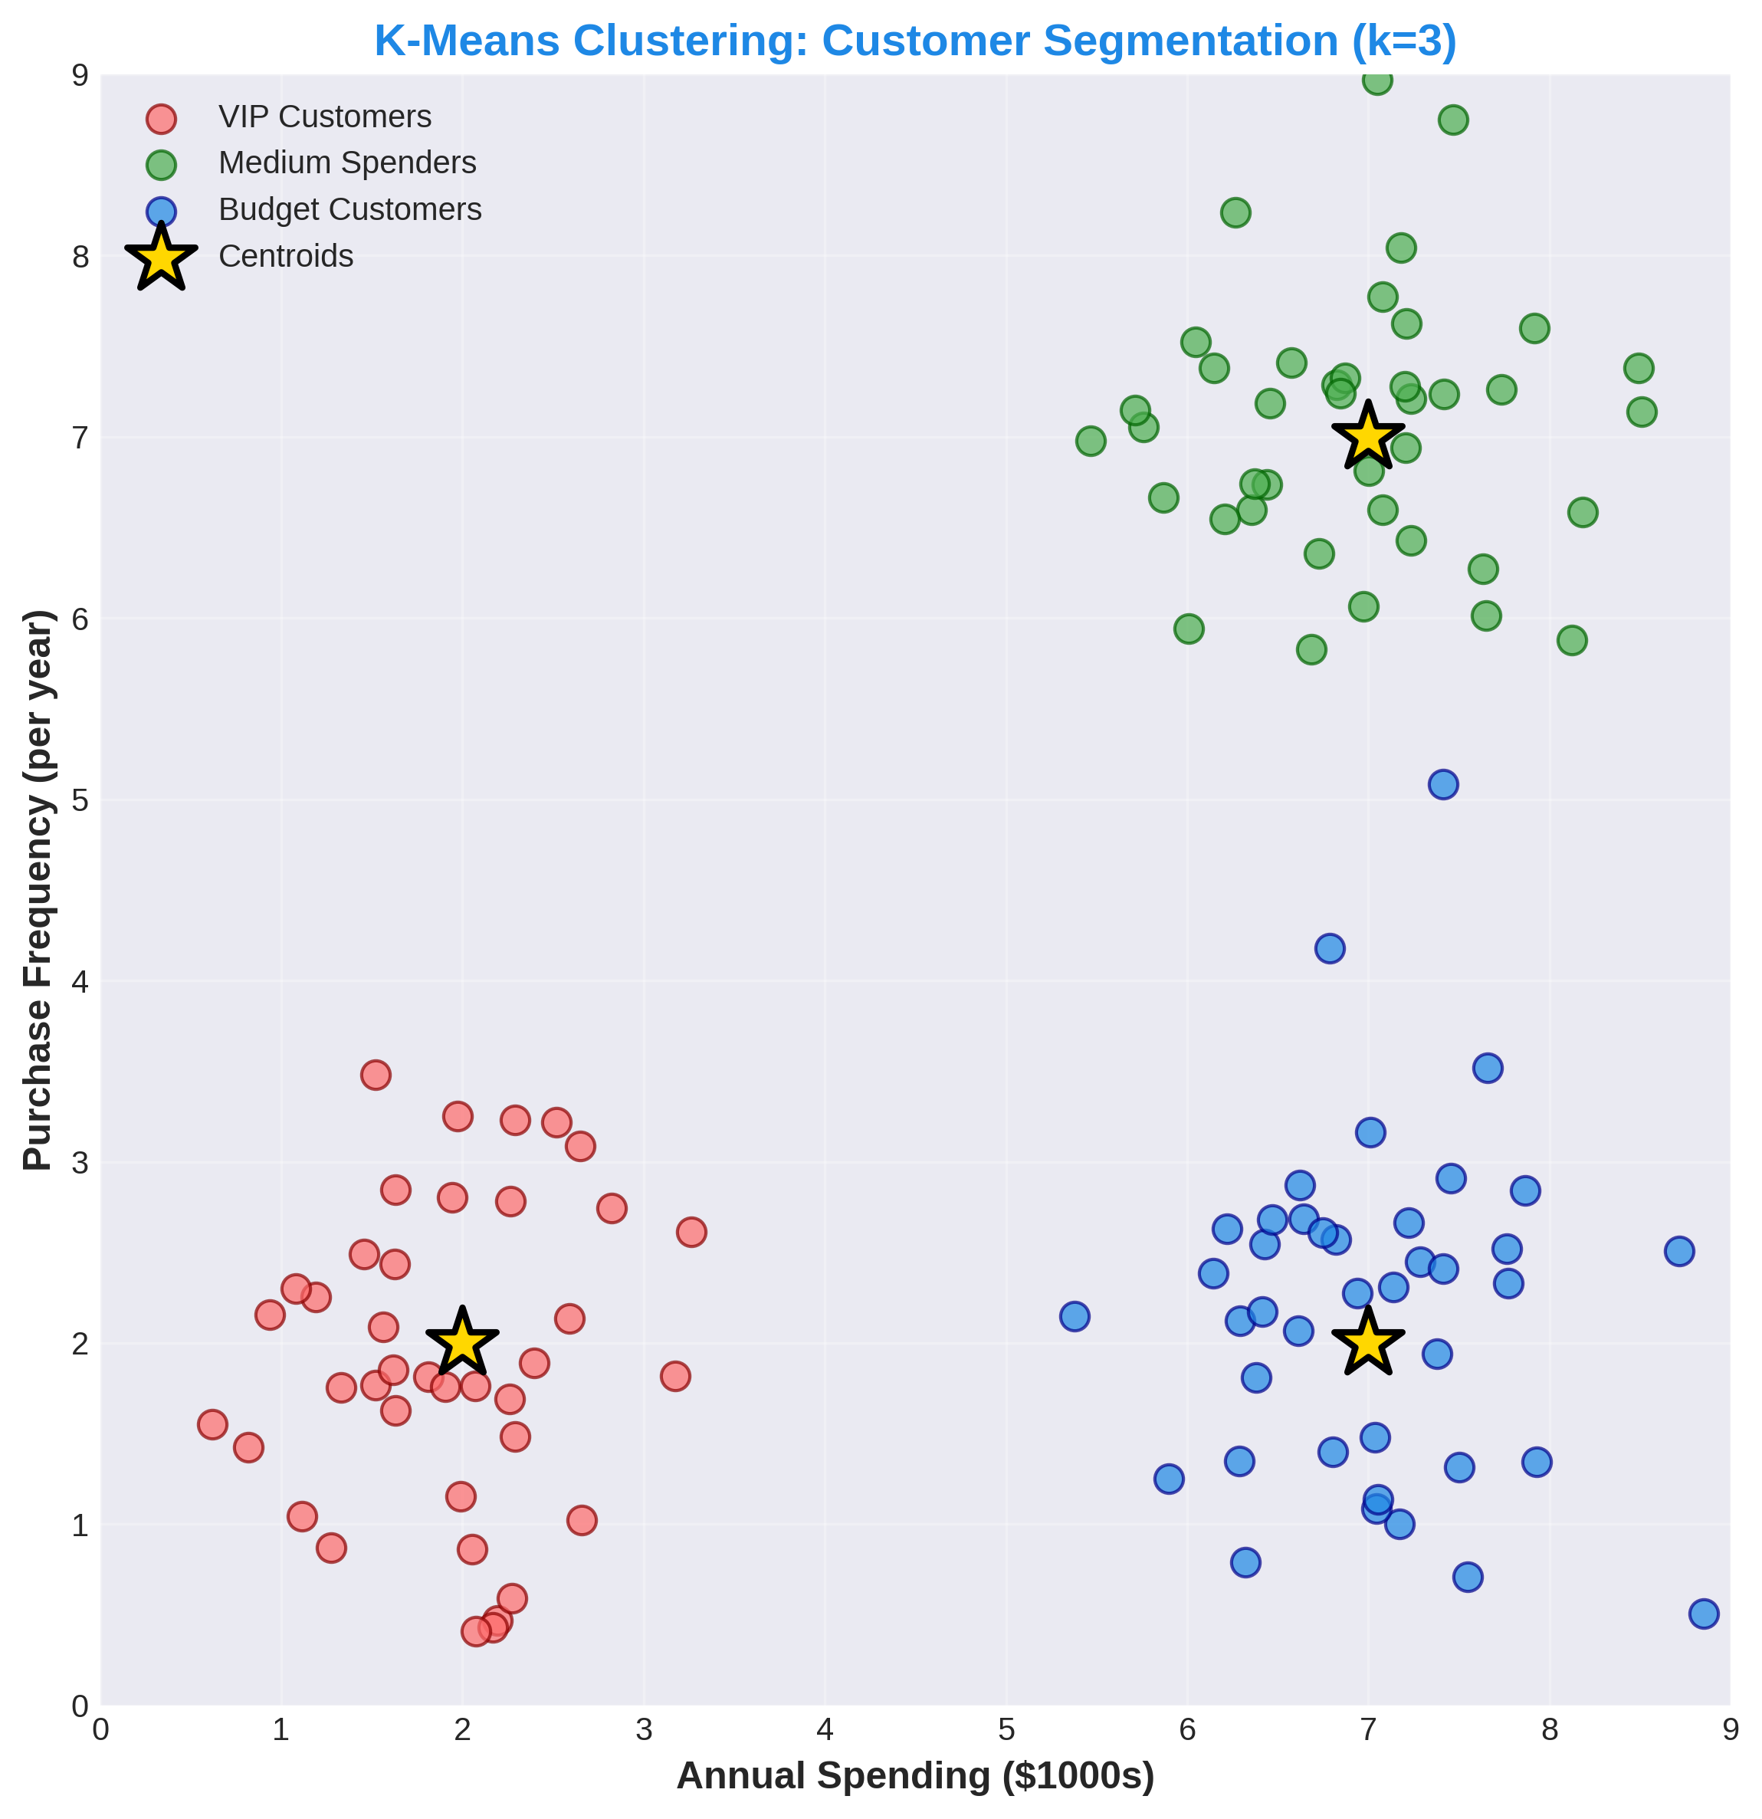
1. K-Means - Clustering Visualization

Slide 4
1. K-Means - Applications
Real Use Cases
• Customer segmentation
• Image compression
• Document clustering
• Gene sequence analysis
• Recommendation systems
Pros & Cons
✓ Fast & scalable
✓ Simple to implement
✓ Works well for spherical
✗ Need to specify k
✗ Sensitive to initialization

Slide 5
1. K-Means - Summary
Type: Partitioning-based, centroid-based
Output: k clusters with centroid points
Algorithm: Iterative: assign → update → repeat
Best For: Fast clustering, spherical clusters
Problem: Need to choose k, random initialization
Code: from sklearn.cluster import KMeans

Slide 6
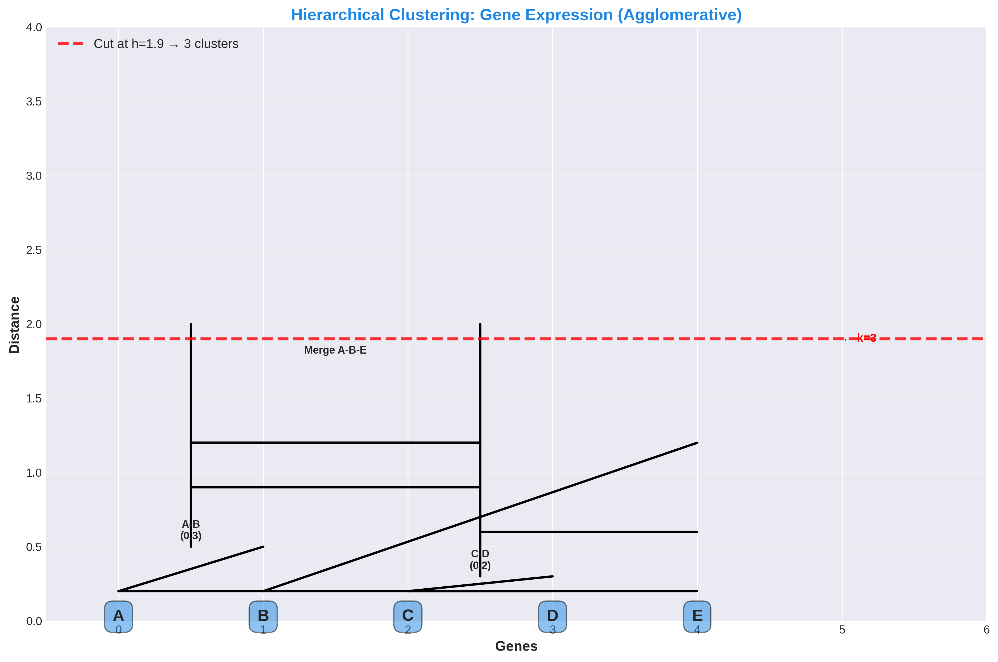
2. Hierarchical Clustering - Dendrogram

Slide 7
2. Hierarchical Clustering - Applications
Real Use Cases
• Gene expression analysis
• Document clustering
• Image segmentation
• Biological taxonomy
• Customer profiling
Pros & Cons
✓ Dendrogram visualization
✓ No k needed
✓ Works with any distance
✗ Slower O(n²) to O(n³)
✗ Sensitive to outliers

Slide 8
2. Hierarchical Clustering - Summary
Types: Agglomerative (bottom-up), Divisive (top-down)
Output: Dendrogram showing hierarchy
Linkage: Single, Complete, Average, Ward
Best For: Hierarchical structure, visualization
k Selection: Cut dendrogram at desired height
Code: from scipy.cluster.hierarchy import dendrogram, linkage

Slide 9
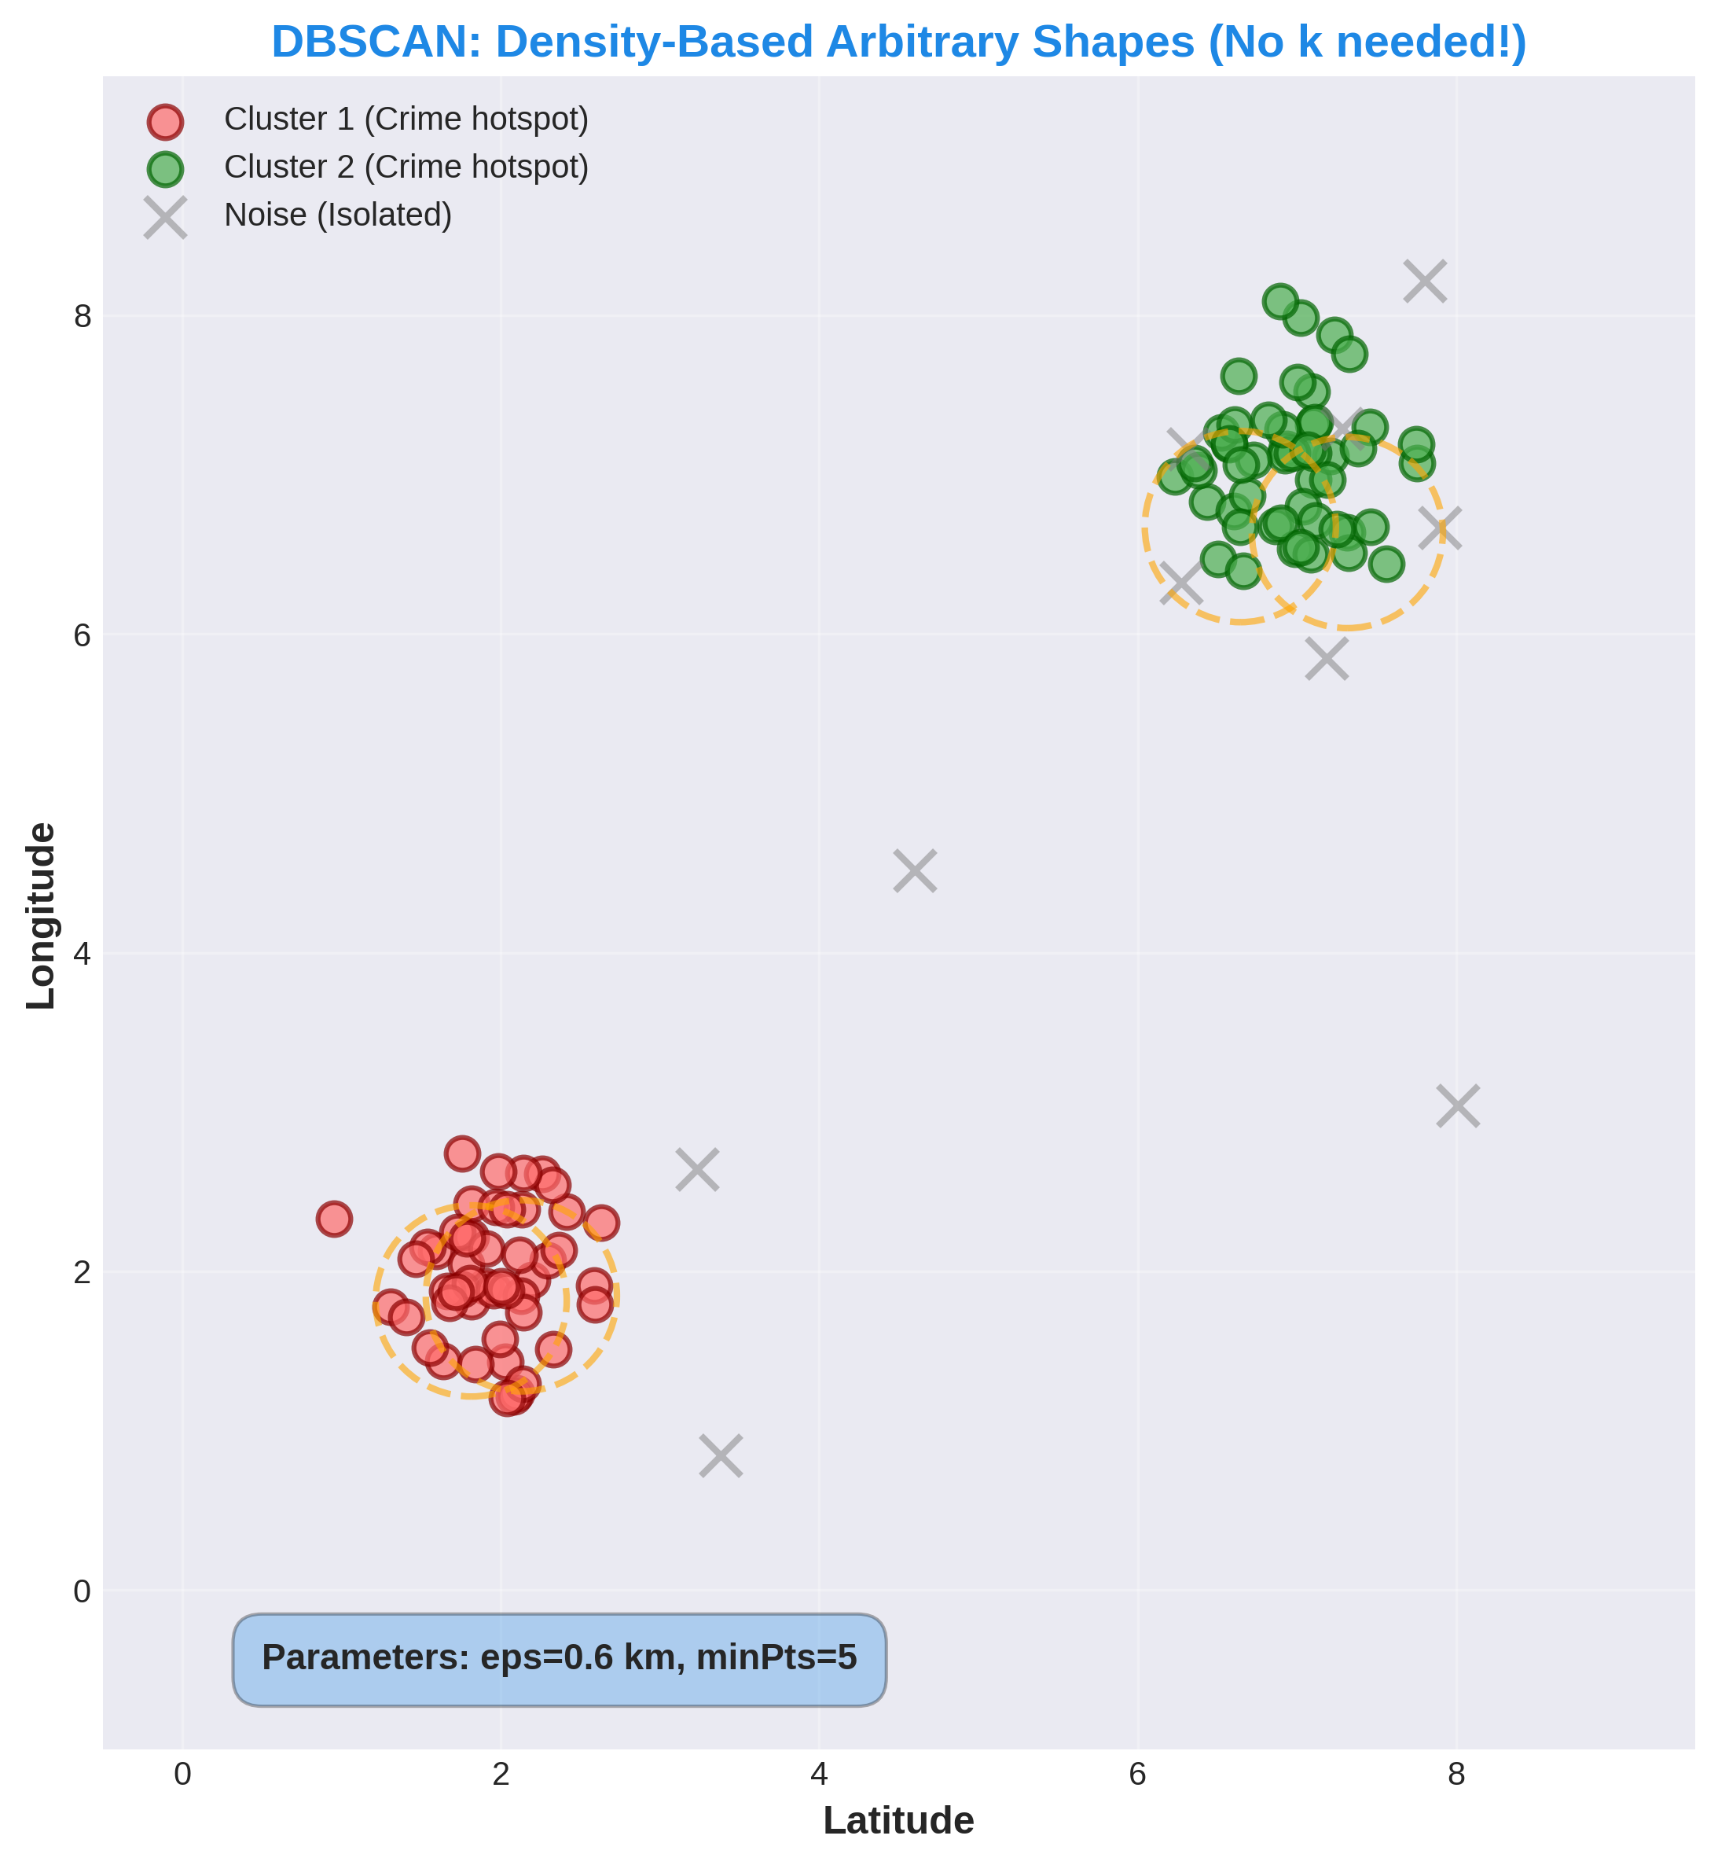
3. DBSCAN - Arbitrary Shapes

Slide 10
3. DBSCAN - Applications
Real Use Cases
• Anomaly/outlier detection
• Spatial clustering
• Traffic accident hotspots
• Intrusion detection
• Galaxy clustering (astronomy)
Pros & Cons
✓ No k specification
✓ Finds arbitrary shapes
✓ Outlier detection built-in
✗ eps/minPts tuning hard
✗ Slow O(n²) on large data

Slide 11
3. DBSCAN - Summary
Type: Density-based, arbitrary shapes
Key Parameters: eps (radius), minPts (min points)
Point Types: Core (>= minPts nearby), Border, Noise
Best For: Non-spherical clusters, outlier detection
k Selection: Not needed! Auto-detects clusters
Code: from sklearn.cluster import DBSCAN

Slide 12
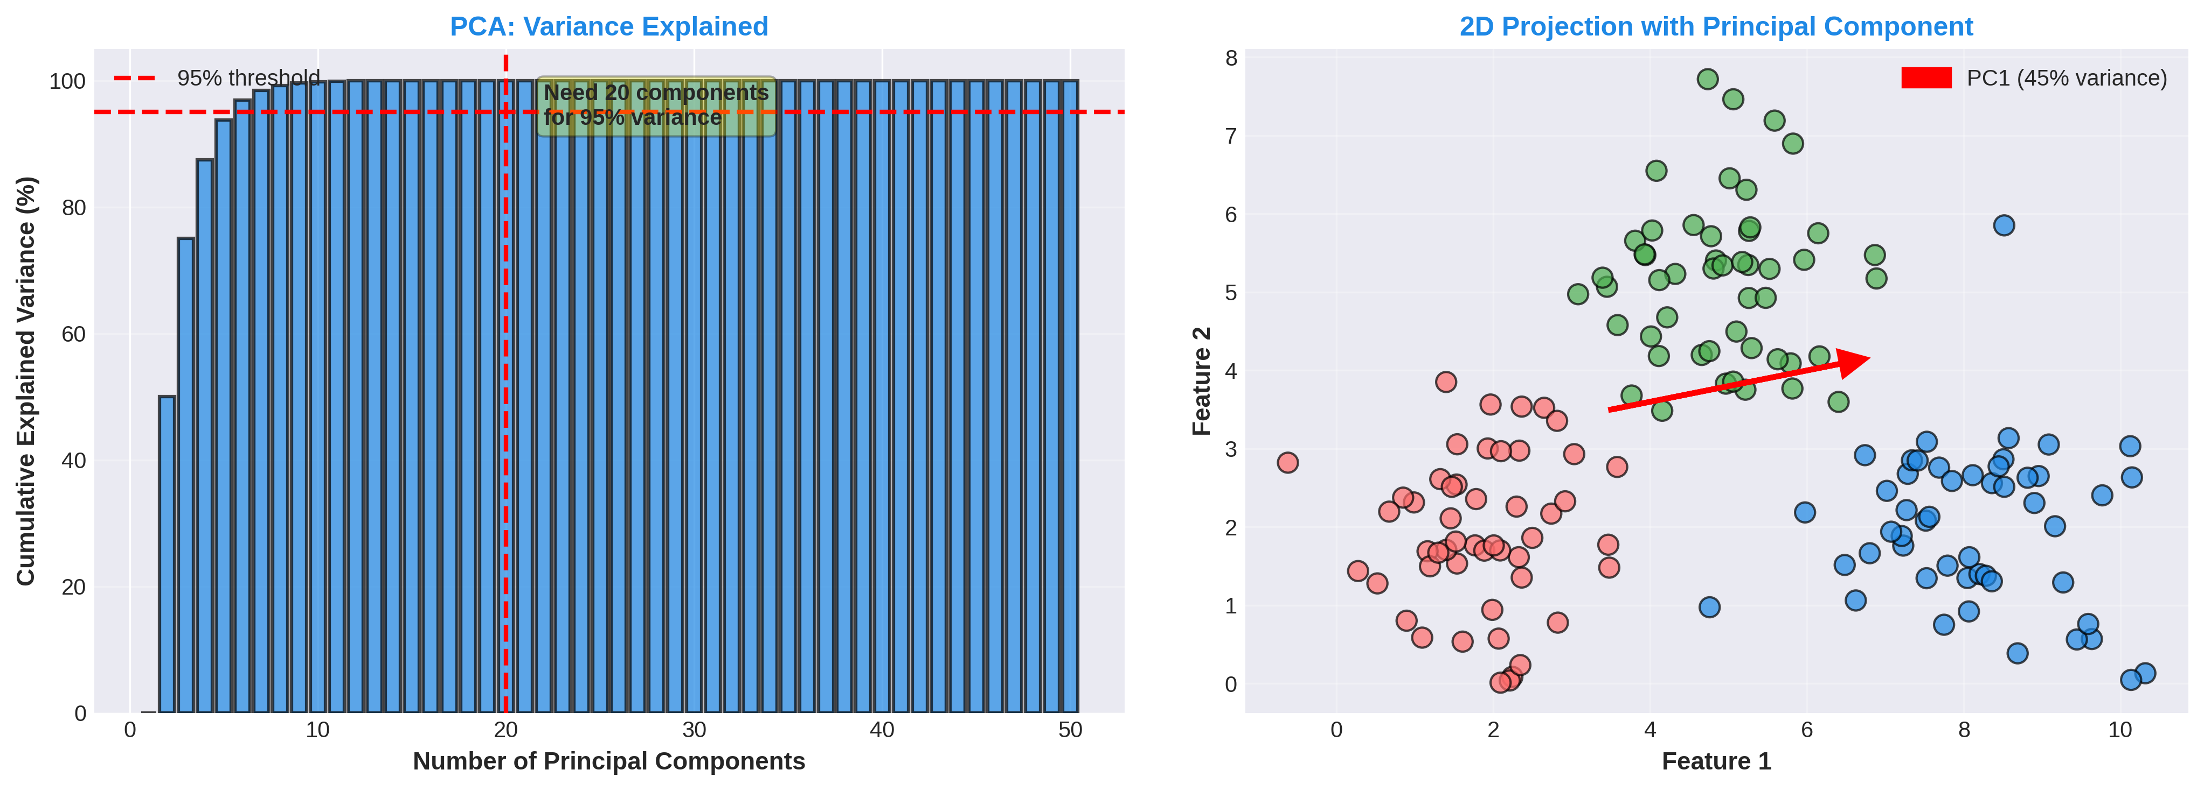
4. PCA - Variance Preservation

Slide 13
4. PCA - Applications
Real Use Cases
• Face recognition (FBI)
• Image compression
• Gene expression analysis
• Stock market analysis
• Noise reduction
Pros & Cons
✓ Reduces dimensions
✓ Preserves variance
✓ Removes correlation
✓ Faster training
✗ Hard to interpret
✗ Linear only

Slide 14
4. PCA - Summary
Type: Dimensionality reduction, variance-preserving
Output: Principal components (eigenvalues/eigenvectors)
Process: Standardize → Covariance → Eigendecomposition
Best For: High-dim data, visualization, compression
Limitation: Linear only (use Kernel-PCA for non-linear)
Code: from sklearn.decomposition import PCA

Slide 15
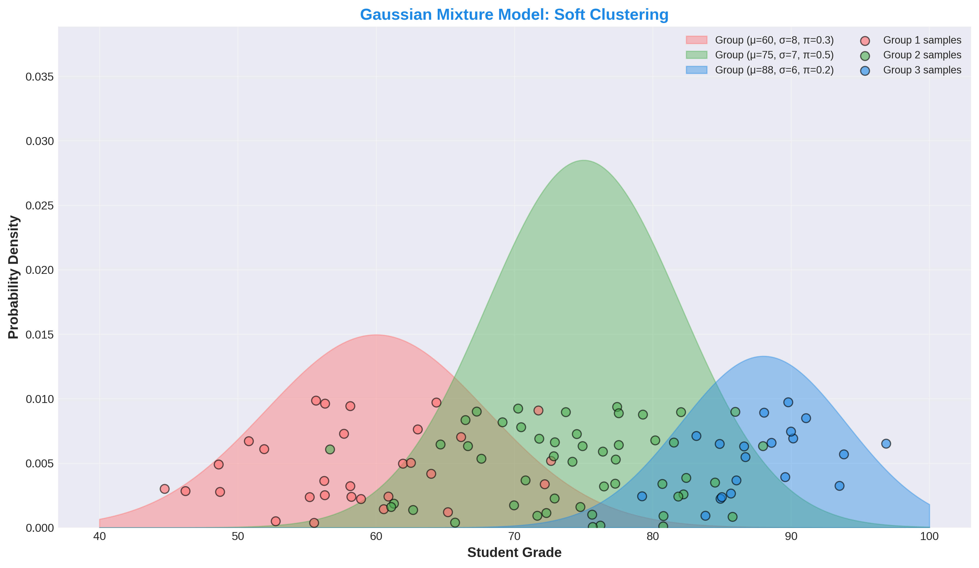
5. GMM - Probabilistic Clustering

Slide 16
5. GMM - Applications
Real Use Cases
• Speech recognition
• Image segmentation
• Topic modeling (documents)
• Medical diagnosis
• Anomaly detection
Pros & Cons
✓ Probabilistic model
✓ Soft clustering
✓ Flexible shapes
✓ Parameter estimation
✗ Slower EM iterations
✗ Can get stuck locally

Slide 17
5. GMM - Summary
Type: Probabilistic, soft clustering
Assumption: Data = mixture of k Gaussian distributions
Parameters: μ (mean), Σ (covariance), π (weight)
Algorithm: EM (Expectation-Maximization)
Output: Probability of cluster membership
Best For: Overlapping clusters, probability needed
Code: from sklearn.mixture import GaussianMixture

Slide 18
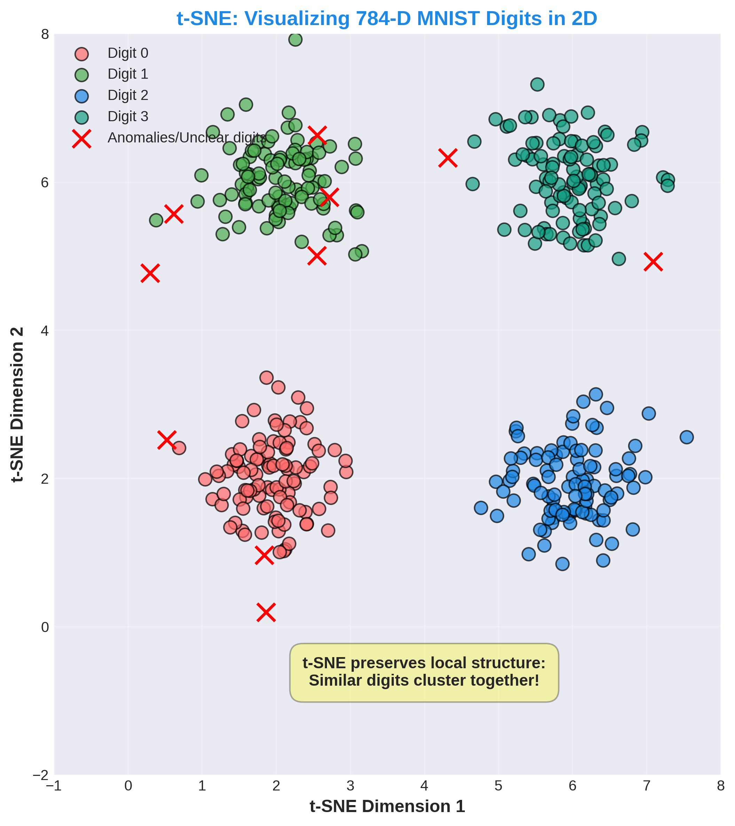
6. t-SNE - High-Dimensional Visualization

Slide 19
6. t-SNE - Applications
Real Use Cases
• Visualize embeddings
• Gene expression plots
• Document clustering viz
• Image similarity viz
• Anomaly detection viz
Pros & Cons
✓ Beautiful visualizations
✓ Preserves local structure
✓ Reveals clusters clearly
✗ Slow O(n²)
✗ Not for downstream ML
✗ Random initialization

Slide 20
6. t-SNE - Summary
Type: Dimensionality reduction for visualization
Output: 2D or 3D coordinates for plotting
Distance Metric: Uses t-distribution (heavy tails)
Local Structure: Preserves neighborhood relationships
Computation: O(n²) - slow but worth it for viz
Best For: Exploratory data analysis, visualization
Code: from sklearn.manifold import TSNE

Slide 21
Algorithm Comparison & When to Use Each
K-Means → Spherical clusters, need k → Customer segments
Hierarchical → Tree structure, no k needed → Gene clustering
DBSCAN → Arbitrary shapes, outliers → Crime hotspots
PCA → Dimensionality reduction → Face recognition
GMM → Probabilistic, soft clustering → Speech recognition
t-SNE → Visualization, local structure → Cluster visualization

Slide 22
Key Concepts: Unsupervised Learning
Clustering: Group similar points together (hard or soft)
Dimensionality Reduction: Reduce features while keeping information
Hard vs Soft Clustering: Hard: each point to one cluster | Soft: probability
Distance Metrics: Euclidean, Manhattan, Cosine (choose wisely!)
Elbow Method: Find optimal k by looking at cost vs clusters
Silhouette Score: Measure how similar points are to own vs other clusters

